Slide 1

By : Arjun Kumar Gaire

Slide 2

A proposal is a formal suggestion.
A research proposal is a detailed plan of the research to be conducted.
The research proposal provides the basis for evaluation of the submitted project or thesis.
Many institutions require that proposal must be submitted before that is finally approved.
is an important aspect of research process.

Slide 3

A proposal is a document that request support-usually money- for work a proposer wants to do.
what makes a proposal a proposal is that it asks the audience to approve, fund, or grant permission to do the proposed project.

Slide 4

To ensure a workable experimental research design which, when implemented, may result into analyze and interpreted the price of research.
The writing of a research proposal is an important aspect of research process

Slide 5

While preparing a research proposal the following are the main section that are generally followed

Slide 6
Title page
Specific formats for title pages vary from one proposal to another but most include the following:
    The title of the proposal ( as short as informative as possible)
    A reference number for the proposal
    The name of the potential funder ( the recipient of the proposal)
    The proposal's date of submission
    The signature of the project director and responsible administrator(s ) in the proposer`s institution or company

Slide 7

The Abstract is a very important part of the proposal because it provides a short overview and summary of the entire proposal.
The Abstract of the proposal is short, often 200 words or less.
In a short proposal addressed to someone within the writer's institution, the Abstract may be located on the title page.
In a long proposal, the Abstract will usually occupy a page by itself following the Title page.
The Abstract should briefly define the problem and its importance, the objectives of the project, the method of evaluation, and the potential impact of the project.

Slide 8

The table of contents lists the sections and subsections of the proposal and their page numbers.

Slide 9
Plan the introduction to your proposal carefully. Make sure it does all of the following things (but not necessarily in this order) that apply to your particular proposal:
  Indicate that the document to follow is a proposal.
  Refer to some previous contact with the recipient of the proposal or to your source of information about the project.
  Find one brief motivating statement that will encourage the recipient to read on and to consider doing the project.
  Give an overview of the contents of the proposal.

Slide 10

Often occurring just after the introduction.
The background section discusses what has brought about the need for the project,
  what problem, what opportunity there is for improving things,
  what the basic situation is.
It's true that the audience of the proposal may know the problem very well, in which case this section might not be needed.
Writing the background section still might be useful, however, in demonstrating your particular view of the problem.
  if the proposal is unsolicited, a background section is almost a requirement
  you will probably need to convince the audience that the problem or opportunity exists and that it should be addressed.

Slide 11

Most proposals discuss the advantages or benefits of doing the proposed project. This acts as an argument in favor of approving the project. Also, some proposals discuss the likelihood of the project's success. In the unsolicited proposal, this section is particularly important.

Slide 12

In most proposals, you'll want to explain how you'll go about doing the proposed work, if approved to do it. This acts as an additional persuasive element; it shows the audience you have a sound, well-thought-out approach to the project. Also, it serves as the other form of background some proposals need. Remember that the background section (the one discussed above) focused on the problem or need that brings about the proposal. However, in this section, you discuss the technical background relating to the procedures or technology you plan to use in the proposed work.

Slide 13

Most proposals contain a section that shows not only the projected completion date but also key milestones for the project. If you are doing a large project spreading over many months, the timeline would also show dates on which you would deliver progress reports. And if you can't cite specific dates, cite amounts of time or time spans for each phase of the project.

Slide 14

Most proposals contain a summary of the proposing individual's or organization's qualifications to do the proposed work. It's like a mini-resume contained in the proposal. The proposal audience uses it to decide whether you are suited for the project. Therefore, this section lists work experience, similar projects, references, training, and education that shows familiarity with the project.

Slide 15

Most proposals also contain a section detailing the costs of the project, whether internal or external. With external projects, you may need to list your hourly rates, projected hours, costs of equipment and supplies, and so forth, and then calculate the total cost of the complete project. With internal projects, there probably won't be a fee, but you should still list the project costs: for example, hours you will need to complete the project, equipment and supplies you'll be using, assistance from other people in the organization, and so on.

Slide 16

The final paragraph or section of the proposal should bring readers back to a focus on the positive aspects of the project (you've just showed them the costs). In the final section, you can end by urging them to get in touch to work out the details of the project, to remind them of the benefits of doing the project, and maybe to put in one last plug for you or your organization as the right choice for the project.

Slide 17

Appendices (supplementary material that is collected and appended at the end of a proposal)should be devoted to those aspects of your project that are of secondary interest to the reader. Begin by assuming that the reader will only have a short time to read your proposal and it will only be the main body of your proposal (not the Appendices). Then, assume that you have gotten the attention of the reader who would now like some additional information. This is the purpose of the Appendices.

Slide 18
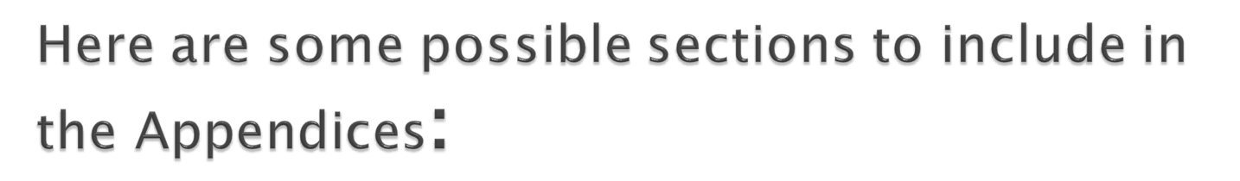
Dissemination Plan - An important aspect of your proposal will be the plan for disseminating information of/from the project to other audiences. Most funding agencies are interested in seeing how their financial support of your project will extend to other audiences. This may include newsletters, workshops, radio broadcasts, presentations, printed handouts, slide shows, training programs, etc. If you have an advisory group involved with your project they can be very helpful in disseminating project information to other audiences.
Time Line - A clear indication of the time frame for the project and the times when each aspect of the project will be implemented. Try creating the time line as a graphic representation (not too many words). If done well, it will help demonstrate the feasibility of the project in a very visible way.
Letters of Support - Funding agencies would like to know that others feel strongly enough about your project that they are willing to write a letter in support of the project. Talk through with the potential letter writers the sort of focus that you think will be important for their letter. (Try and draw on the reputation of the letter writing group.) Do not get pushed into writing the letters for the agencies - they will all sound alike and will probably defeat your purpose of using them. The letters must be substantive. If not, do not use them! Have the letters addressed directly to the funding agency. (Do not use a general "To Whom It May Concern" letter - it makes it appear that you are applying to many different potential funding agencies and are using the same letter for each. This may really be the case, so make sure you personalize each letter to the specific potential funding agency).

Slide 19

As for the organization of the content of a proposal, remember that it is essentially a sales, or promotional kind of thing. Here are the basic steps it goes through:
You introduce the proposal, telling the readers its purpose and contents.
You present the background—the problem, opportunity, or situation that brings about the proposed project. Get the reader concerned about the problem, excited about the opportunity, or interested in the situation in some way.
State what you propose to do about the problem, how you plan to help the readers take advantage of the opportunity, how you intend to help them with the situation.
Discuss the benefits of doing the proposed project, the advantages that come from approving it.
Describe exactly what the completed project would consist of, what it would look like, how it would work—describe the results of the project.
Discuss the method and theory or approach behind that method—enable readers to understand how you'll go about the proposed work.
Provide a schedule, including major milestones or checkpoints in the project.
Briefly list your qualifications for the project; provide a mini-resume of the background you have that makes you right for the project.
Now (and only now), list the costs of the project, the resources you'll need to do the project.
Conclude with a review of the benefits of doing the project (in case the shock from the costs section was too much), and urge the audience to get in touch or to accept the proposal.

Slide 20

You have the following options for the format and packaging of your proposal. It does not matter which you use as long as you use the memorandum format for internal proposals and the business-letter format for external proposals

Slide 21
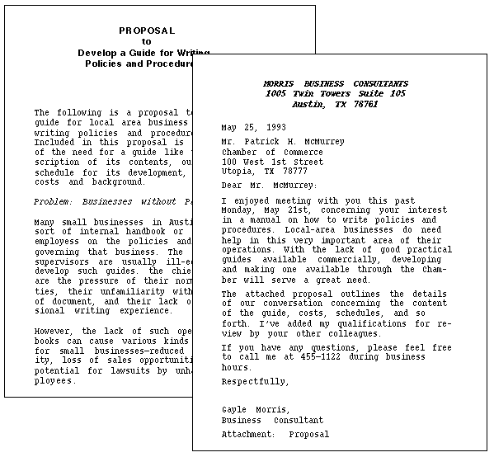


Slide 22

2. Cover memo with separate proposal: In this format, you write a brief "cover" memo and attach the proposal proper after it. The cover memo briefly announces that a proposal follows and outlines the contents of it. In fact, the contents of the cover memo are pretty much the same as the introduction. The proposal proper that repeats much of what's in the cover memo. This is because the memo may get detached from the proposal or the reader may not even bother to look at the memo and just dive right into the proposal itself.

Slide 23
3. Business-letter proposal: In this format, you put the entire proposal within a standard business letter. You include headings and other special formatting elements as if it were a report. (This format is illustrated in the left portion of the illustration below)
4. Memo proposal: In this format, you put the entire proposal within a standard office memorandum. You include headings and other special formatting elements as if it were a report. This format is illustrated in the right portion of the illustration below)

Slide 24
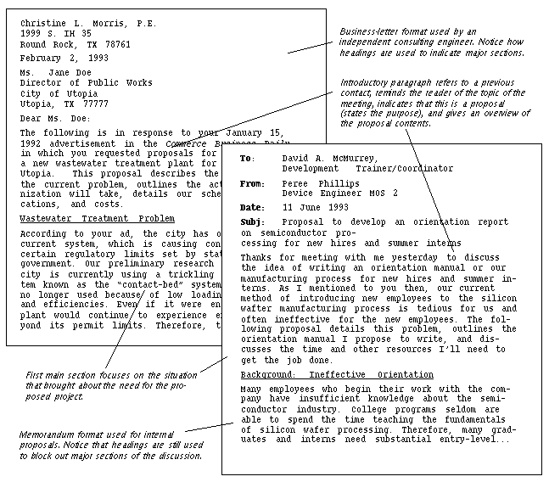

Slide 25

As you reread and revise your proposal, watch out for problems such as the following:
Make sure you use the right format. Remember, the memo format is for internal proposals; the business-letter format is for proposals written from one external organization to another. (Whether you use a cover memo or cover letter is your choice.)
Write a good introduction—in it, state that this is a proposal, and provide an overview of the contents of the proposal.
Make sure to identify exactly what you are proposing to do.
Make sure that a report—a written document—is somehow involved in the project you are proposing to do. Remember that in this course we are trying to do two things: write a proposal and plan a term-report project.
Make sure the sections are in a logical, natural order. For example, don't hit the audience with schedules and costs before you've gotten them interested in the project.
Break out the costs section into specifics; include hourly rates and other such details. Don't just hit them with a whopping big final cost.
For internal projects, don't omit the section on costs and qualifications: there will be costs, just not direct ones. For example, how much time will you need, will there be printing, binding costs? Include your qualifications—imagine your proposal will go to somebody in the organization who doesn't know you.

Slide 26
  Review of related literatures
  Hypothesis
  Methods of data collection and analysis
  Time schedule and budget
  Expected result
  References and Bibliography
  Appendix.

